Slide 1
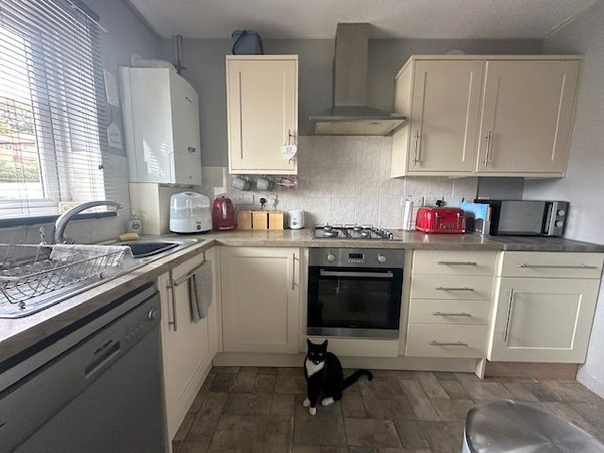
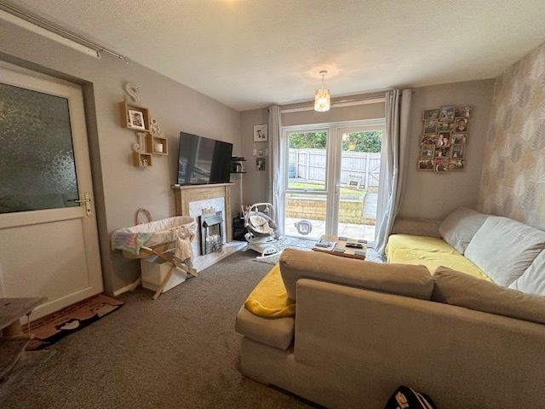
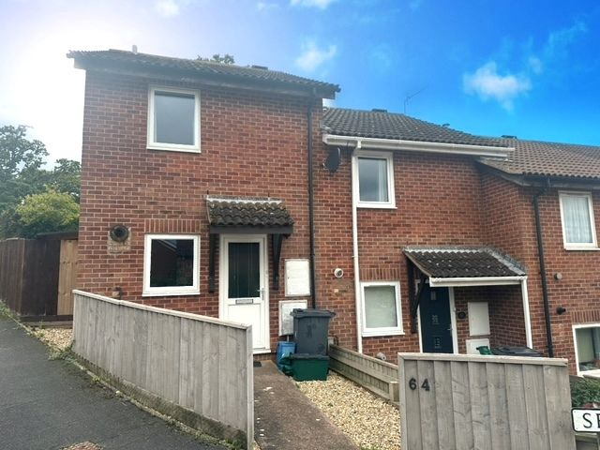
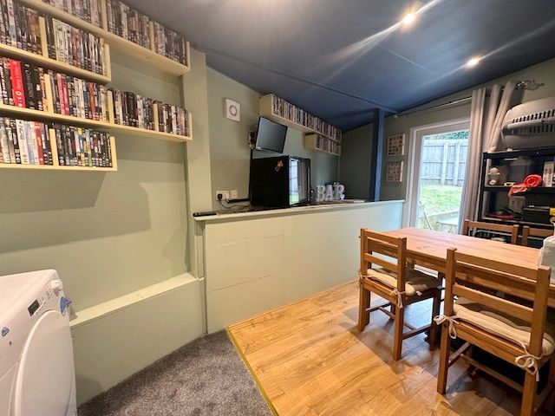
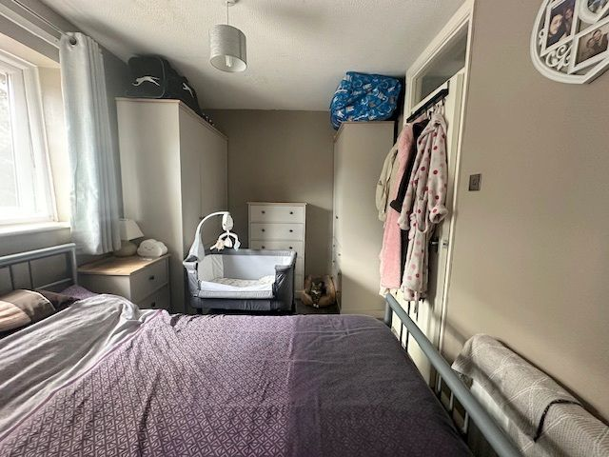
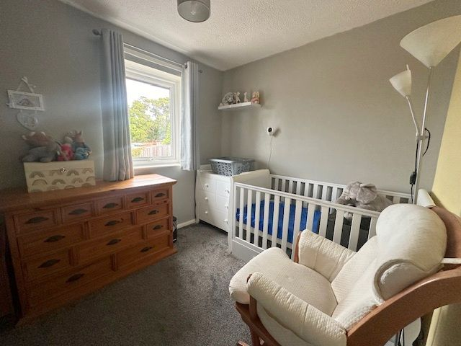
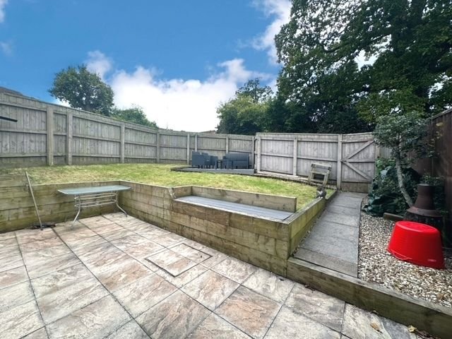
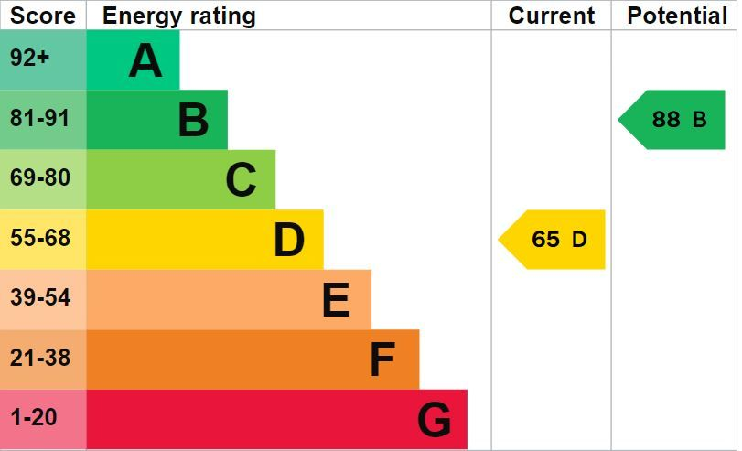
www.pennys.net
64 Dukes Crescent, Exmouth, EX8 4SD
GUIDE PRICE £235,000
TENURE Freehold
A Beautifully Presented Two Bedroom End Link House Situated In A Popular Location With Good Size Enclosed Rear Garden & Parking Space
Reception Hall • Lounge • Modern Fitted Kitchen •
Family Room/Dining Room • Two First Floor Bedrooms •
Family Bathroom/WC • uPVC Double Glazed Windows & Gas Central Heating Via Modern Boiler • Parking Space •
Ideal First Time/Investment Purchase • Viewing Highly Recommended •
Pennys Estate Agents Limited for themselves and for the vendor of this property whose agents they are give notice that:- (1) These particulars do not constitute any part of an offer or a contract. (2) All statements contained in these particulars are made without responsibility on the part of Pennys Estate Agents Limited. (3) None of the statements contained in these particulars are to be relied upon as a statement or representation of fact. (4) Any intending purchaser must satisfy himself/herself by inspection or otherwise as to the correctness of each of the statements contained in these particulars. (5) The vendor does not make or give and neither do Pennys Estate Agents Limited nor any person in their employment has any authority to make or give any representation or warranty whatever in relation to this property.
PENNYS ESTATE AGENTS
2 Rolle House, Rolle Street, Exmouth, Devon, EX8 2SN
Tel: 01395 264111 EMail: help@pennys.net

Slide 2
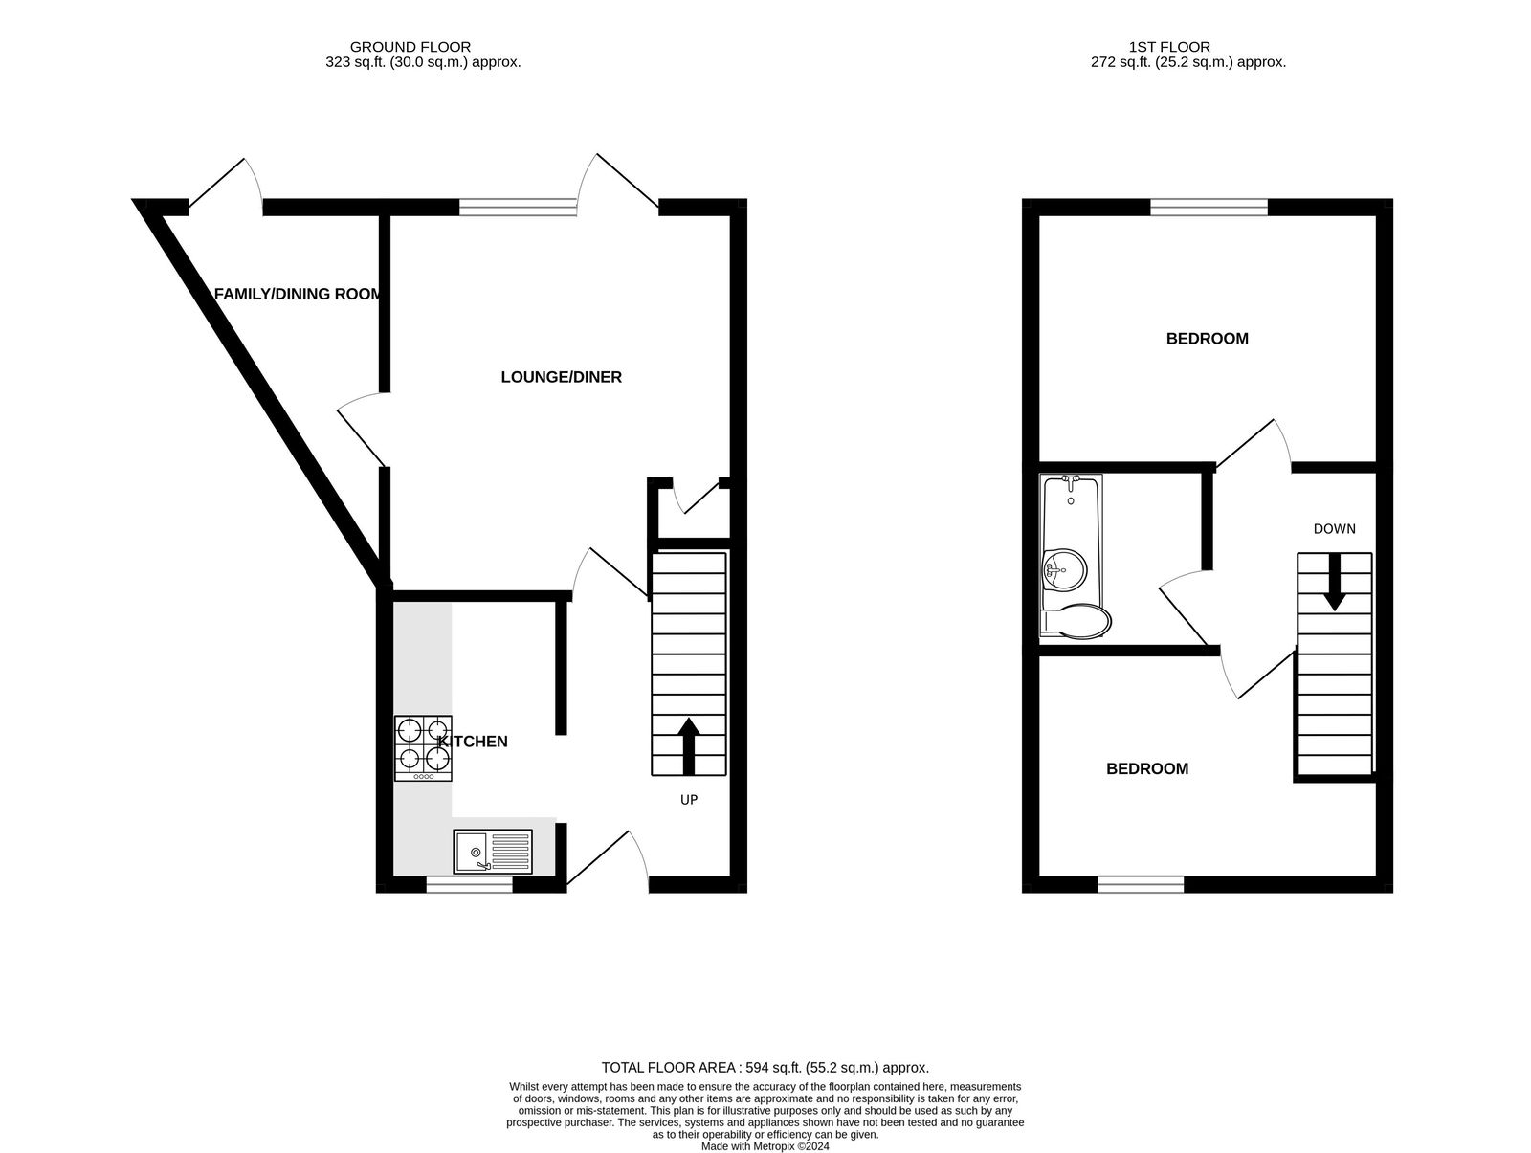
64 Dukes Crescent, Exmouth, EX8 4SD
THE ACCOMMODATION COMPRISES: Entrance canopy with uPVC front door with patterned double glazed window inset giving access to: RECEPTION HALL: With stairs rising to the first floor landing with useful understairs storage area beneath; wood effect flooring; radiator; electric consumer unit; timer and thermostat control for central heating and hot water; doors to: KITCHEN: 2.97m x 1.78m (9'9" x 5'10") A modern kitchen fitted with pattern worktop surfaces and attractive tiled splashbacks; range of cream fronted cupboards, drawer units and space for dishwasher beneath; inset single drainer sink unit with mixer tap; built-in electric oven with four ring gas hob above and stainless steel chimney style extractor hood over; space for upright fridge freezer; wall mounted cupboards; wall mounted Worcester boiler serving domestic hot water and gas central heating; tile effect flooring; uPVC double glazed window to front aspect. LOUNGE: 4.04m x 3.61m (13'3" x 11'10") uPVC double glazed window overlooking the rear garden and uPVC double glazed patio door leading to REAR GARDEN; television point; radiator; living flame effect electric fire housed in marble effect hearth with wooden mantle over; storage cupboard; uPVC double glazed door to: FAMILY ROOM/DINING ROOM: 4.17m x 2.51m (13'8" x 8'3") A useful room which has been added on by the current owners giving additional ground floor living space with plumbing for an automatic washing machine and tumble dryer space; wood effect flooring; ceiling LED spotlights; extractor fan; uPVC double glazed patio door giving access to REAR GARDEN. FIRST FLOOR LANDING: With access to roof space; carpet; smoke alarm; doors to: BEDROOM ONE: 3.61m x 2.41m (11'10" x 7'11") uPVC double glazed window to rear aspect; radiator. BEDROOM TWO: 3.63m maximum into wall recess narrowing to 8'8" (2.64m) x 8'1" (2.46m) uPVC double glazed window to front aspect; radiator. BATHROOM/WC: 1.96m x 1.63m (6'5" x 5'4") A modern suite comprising of bath with mixer tap, shower splash screen and rainfall shower with detachable hand held shower attachment; WC in concealed cistern with push button flush; attractive part tiled walls; wash hand basin set into vanity display unit with cupboards beneath; wall mounted mirror; ceiling LED spotlights; chrome heated towel rail; patterned flooring; extractor fan. OUTSIDE: Enjoying a generous sized corner position in a popular location, the property enjoys a small decorative stone front garden area with a pathway leading to the front of the property. To the rear is a good sized enclosed garden offering a high degree of privacy and seclusion being fully enclosed by timber fencing and enjoying a sunny aspect. There is a spacious patio area ideal for outside dining and entertaining, lawned area edged with wooden sleepers, decorative stone area, composite decking, variety of shrubs and trees, pedestrian gate leading to the rear which gives access to a PARKING SPACE.
FLOOR PLAN:

